Slide 1
ジョゼフィンです。
どうぞよろしく。

Slide 2
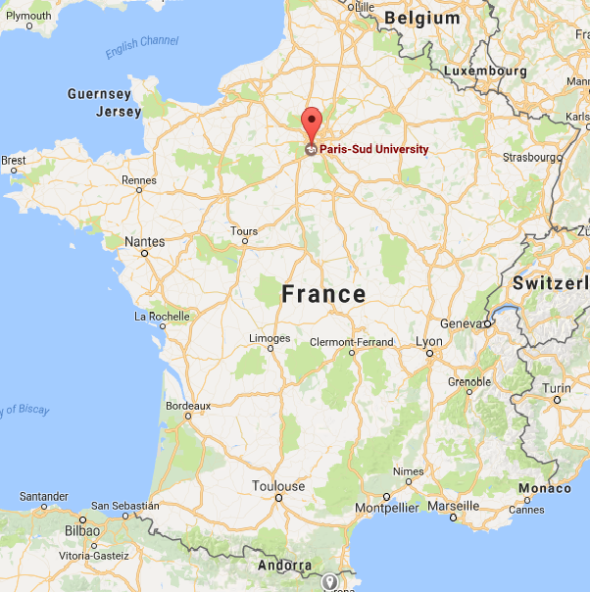
Université Paris-Sud

Slide 3
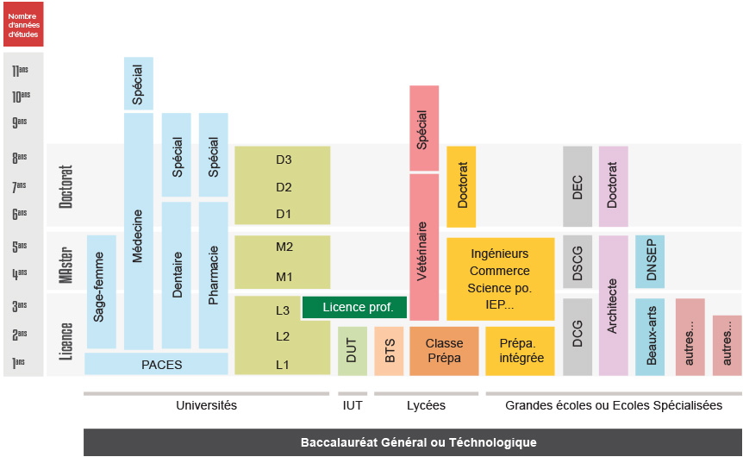
The school system in France
It’s a bit complicated
ENGINEERING SCHOOL
UNIVERSITY

Slide 4
The school system in France
UNIVERSITY
ENGINEERING SCHOOL
Ph.D
Master’s Degree
I’m here !

Slide 5
The school system in France
UNIVERSITY
ENGINEERING SCHOOL
Ph.D
Master’s Degree

Slide 6
My research
Multimodal Person Discovery in Broadcast TV
The goal is to track and identify faces in a video and to associate a name with it.
The name needs to be extracted from the video.

Slide 7
Tracking a face
First it is necessary to track the faces in the video
For this purpose we can use different solutions :
  API like Microsoft Cognitive Services or Face++
  OpenCV

Slide 8
Option 1 : Microsoft Cognitive Services
Free for small files
Very accurate and efficient at tracking faces.
No file bigger than 10 MB accepted.

Slide 9
Option 2 : OpenCV
Free, open-source library dedicated to computer vision.
Built-in face recognition module
Much less accurate than Microsoft’s API

Slide 10
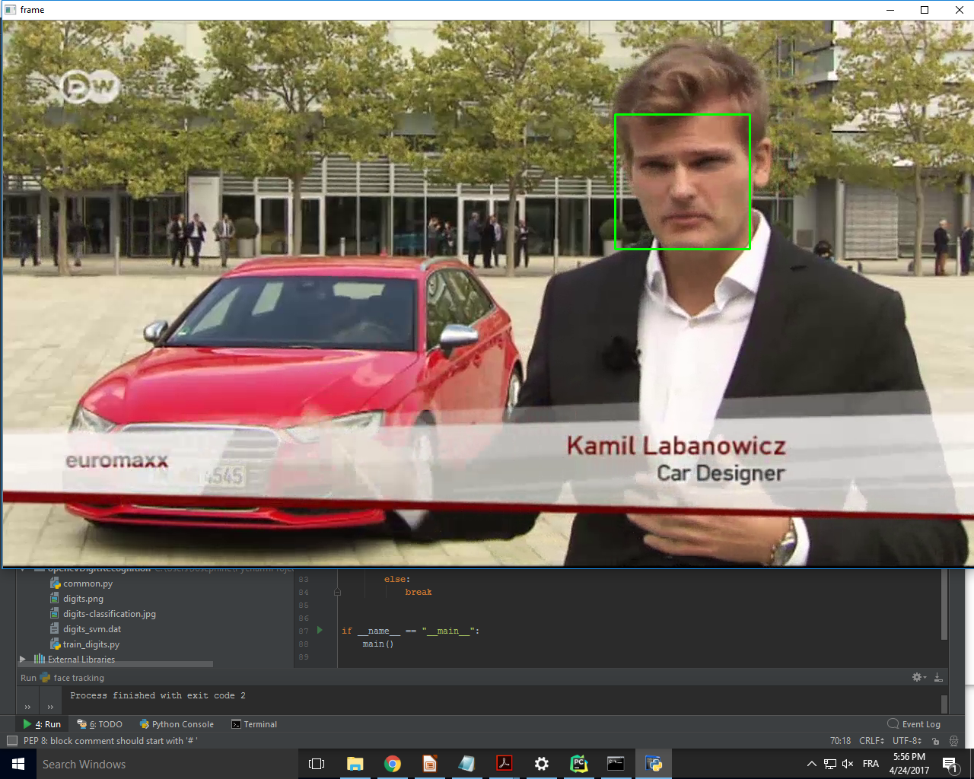
Exemple with OpenCV

Slide 11
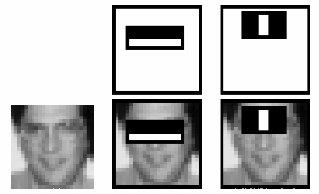
Haar cascade classifiers
These are features that allow a computer program to identify faces
You need to apply 6000+ features to a picture to identify if it’s a face or not
Cascade classifiers solve this problem

Slide 12
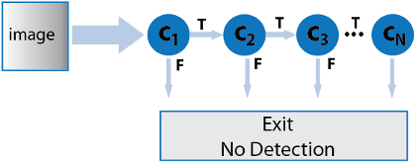
Haar cascade classifiers

